Slide 1
Methods for Mounting
LCD Displays
By John Khalaf
5-23-2016

Slide 2
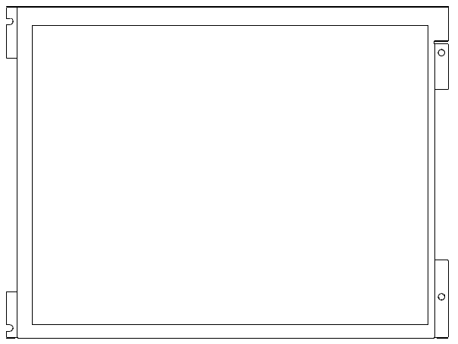

Modules have 3 mounting styles: Side Screws, Front Holes, No Holes
Side
Screws
Front
Holes
No Holes

Slide 3
Disclaimer:
The methods shown in this presentation are for illustrative purposes only.
Your actual methods may be different.

Slide 4
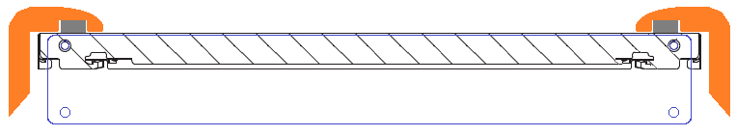
Side Screws Mounting
Two typical screw threads (depends on display):
M2 x 2.5mm depth MAX.
Torque is 2.0kgf cm Or
M3 x 3.9mm depth MAX.
Torque is 0.35Nm
Bezel
Seal
Bracket
Attach bracket to customer housing
Displays should be supported in the center to prevent bowing. (Shown here is a bracket with foam against the back of the display.)

Slide 5
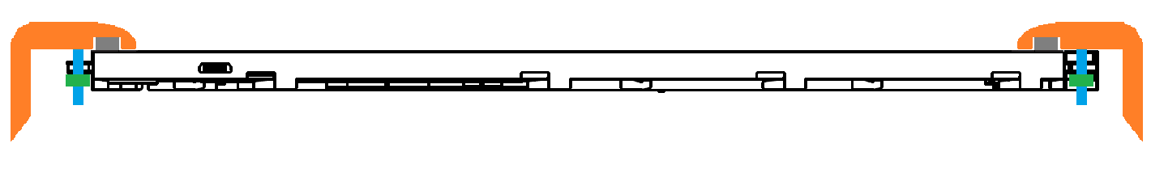
Front Holes Mounting
Bezel
Seal
Stud and Nut
Front
Holes
Displays should be supported in the center to prevent bowing. (Shown here is a bracket with foam against the back of the display.)

Slide 6
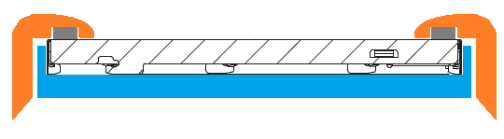
No Holes Mounting
Bezel
Seal
No Holes
Bracket provides full support to the Display edges

